Slide 1


Team 71: Virtual Computer Mouse using mmWave Radar (TI) Bi-Weekly Update 3
Oscar Chavez Araiza
Greyson Heath
Daniel Lu
Zane Meikle
Sponsor: Texas Instruments
TA: Vishwam Raval

Slide 2
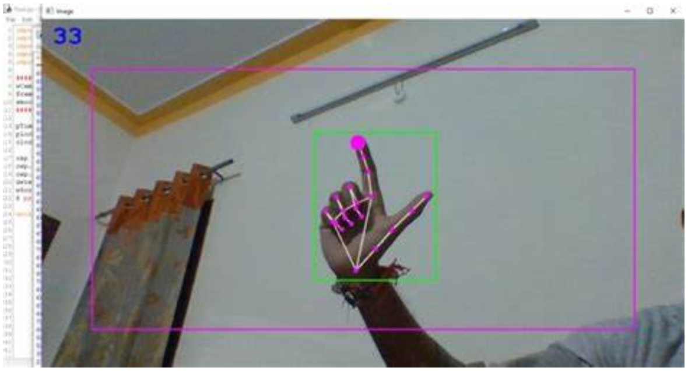
Project Summary:
Problem statement:
Virtual mice today are traditionally done using computer vision and a camera (as seen on the right).
But these systems are processing and power intensive.
High-level summary:
Create a virtual mouse using a Texas Instruments (TI) mmWave Radar and a ML model to make a less power and processing intensive virtual mouse.
#71 - Virtual Mouse using mmWave Radar (TI)

Slide 3
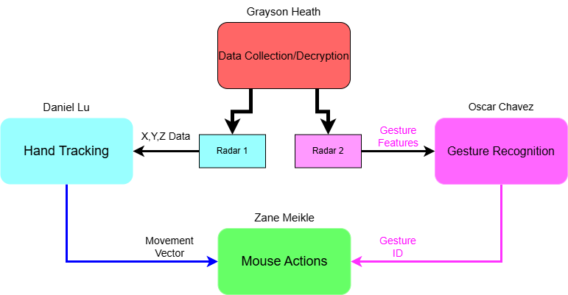
System Overview
#71 - Virtual Mouse using mmWave Radar (TI)

Slide 4
Major Project Changes for 404
Currently, we are integrating what we have. Afterwards, we plan to do the following proposed changes:
Interactive GUI - Provides feedback and sensitivity adjustments (Greyson)
Improving AI for gestures - New gestures for holding clicks (Oscar)
Mouse frame smoothing - Connect point A to point B with arbitrary frames to smooth motion (Zane)
Parallelization of scripts - Parallelize the different scripts so they aren't running in one program (Zane)
Improving accuracy - improve the accuracy of the mouse (Daniel)
Radar enclosure case - Protects devices and looks presentable (Greyson)
#71 - Virtual Mouse using mmWave Radar (TI)

Slide 5
Project Timeline
#71 - Virtual Mouse using mmWave Radar (TI)

Slide 6
Major Updates
The radar is able to move the mouse!
CAD Case Modeled
#71 - Virtual Mouse using mmWave Radar (TI)

Slide 7
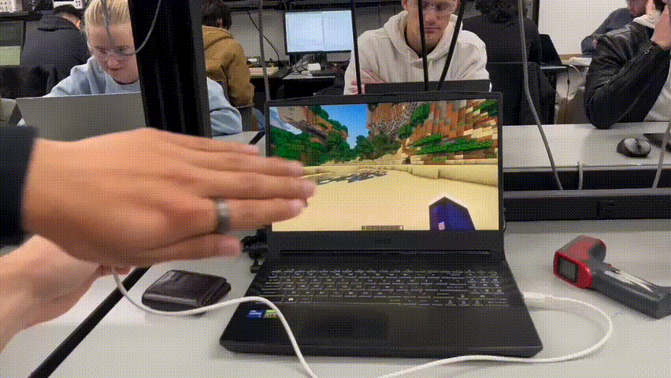
#71 - Virtual Mouse using mmWave Radar (TI)

Slide 8
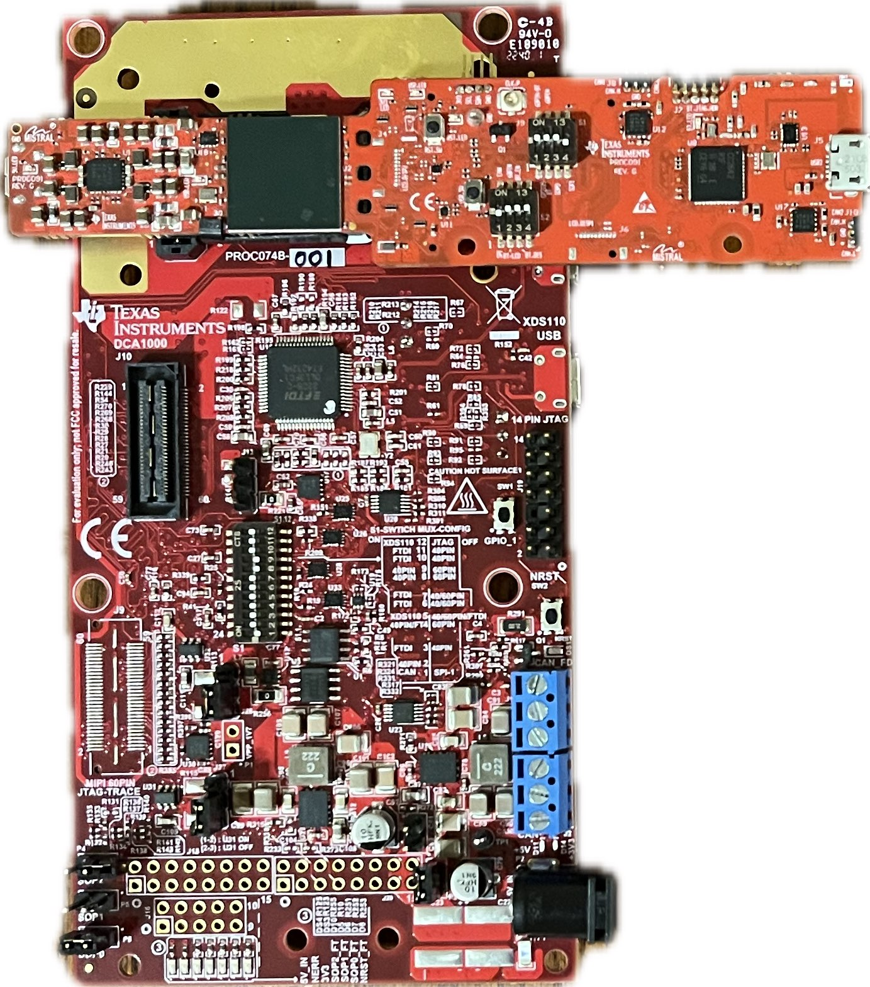

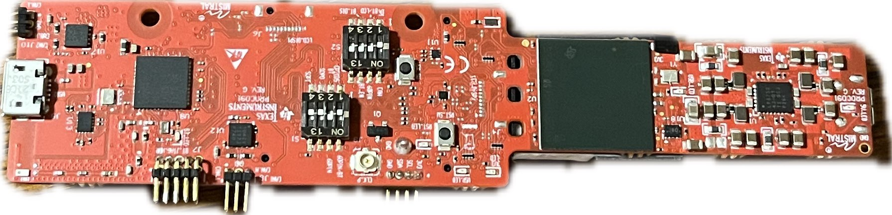
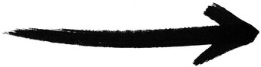
Chirp Config / Collect Data
Greyson Heath
Hours since last presentation <12> hrs | Ongoing progress/problems and plans until the next presentation
<6> Integrating new code, testing movement algorithms, GUI work <5> New CAD Model <1> Sponsor Alignment Meeting | Finding solution for separation/setup of radars due to sensor interference (6 in. apart? Left/Right hands?...) Solidifying Python GUI for integration
~6 in.
#71 - Virtual Mouse using mmWave Radar (TI)

Slide 9
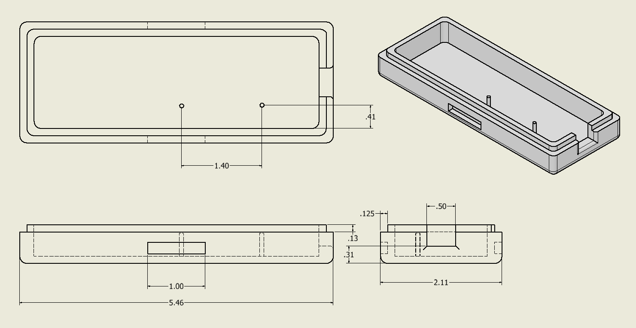
CAD Model (Bottom)
#71 - Virtual Mouse using mmWave Radar (TI)

Slide 10
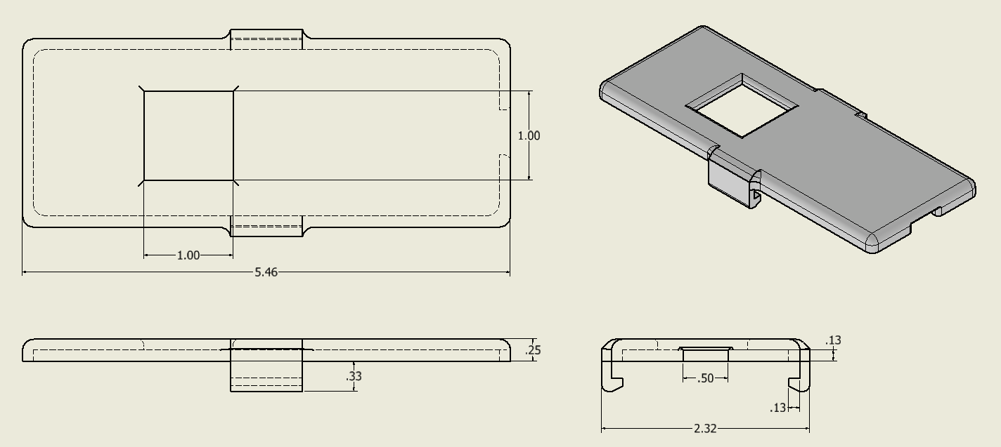
CAD Model (Top)
#71 - Virtual Mouse using mmWave Radar (TI)

Slide 11
-Gesture Recognition-
Oscar Chavez Araiza
Accomplished since 403 <~18> hrs | Ongoing progress/problems and plans until the next presentation
<1> Meeting with sponsor <4> Tested a suggestion from sponsor to use the angles to remake the position data. <11> Helped produce a smoother travel path for the radar. <2> Produced a few scripts to visualize the movement and position based on the radar data. | Problems The data from the radar is very noisy and quite erratic. The gesture recognition binary calculates the angles in an unknown way which makes trying to produce a x-z position hard to do. The produced position takes a while to settle, so it might not be a great way to track the hand movement Progress Currently producing a report for our sponsor to get guidance on retrieving location data from the gesture recognition binary. We believe that if we use a reflective glove, the radar will produce better location data.
#71 - Virtual Mouse using mmWave Radar (TI)

Slide 12
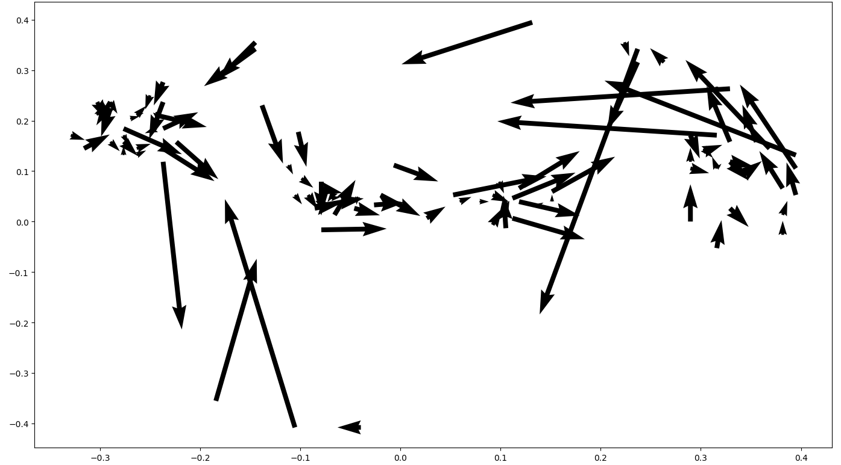
Vector map
Left-to-Right Movement Vector Map
#71 - Virtual Mouse using mmWave Radar (TI)

Slide 13
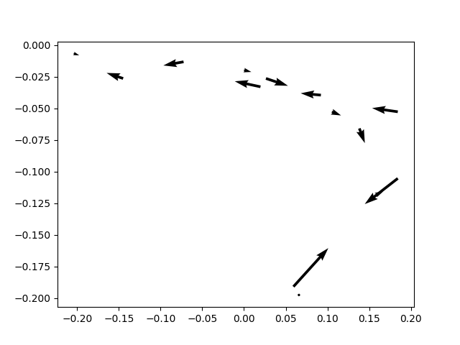
Vector Map
Back and Forth Movement at Ideal Distance

Slide 14
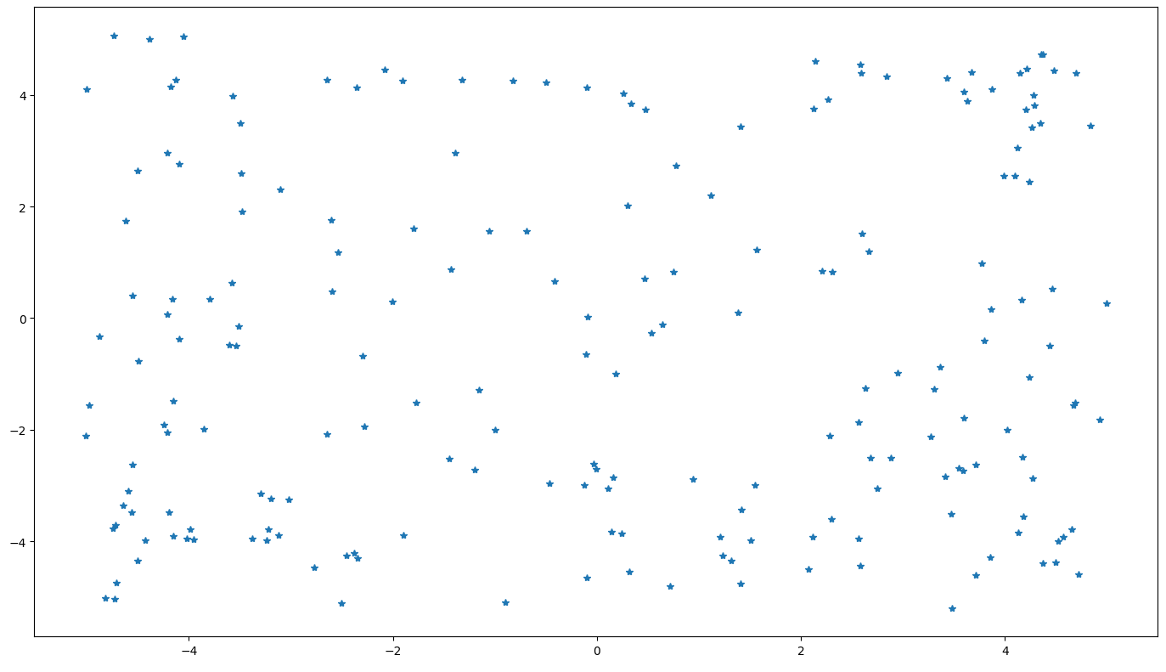
Using Gesture Features for Position
x = sin(azimuth)
y = sin(elevation)
Hand is Making the Shine Gesture

Slide 15
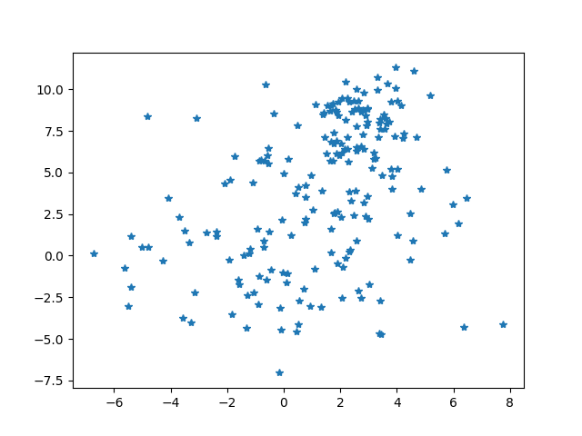
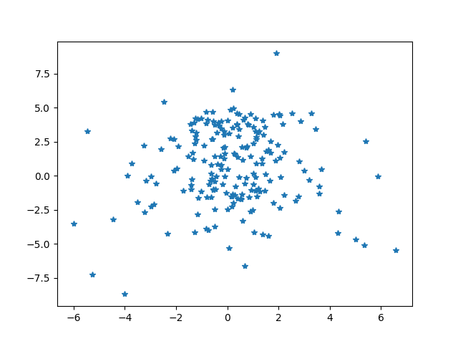
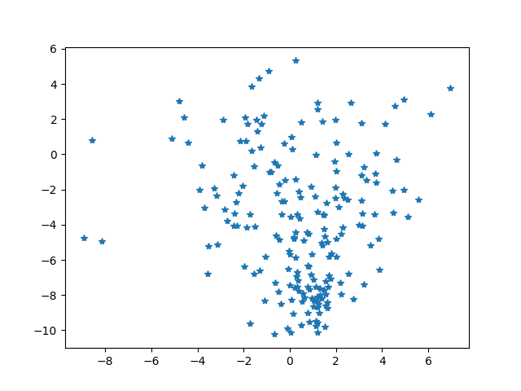
Using Gesture Features for Position
Shine Up
Shine Center
Shine Down

Slide 16
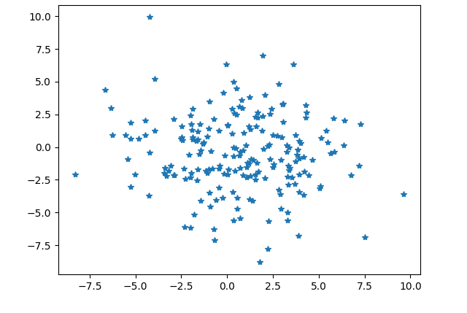
Using Gesture Features for Position
No Gesture Position

Slide 17
Gesture Positioning
Daniel Lu
Accomplishments <10hr> | ECEN 404 ongoing progress/problems in the next 2 weeks
Meeting with sponsor<1hr> Try to improve the moving path that responds faster to the change in direction<6hr> Improve the accuracy of path by reducing the error caused by background objects <3hr> | Problem : the radar randomly generate data points from the environment The weight average velocity responds slowly to the change in direction.
#71 - Virtual Mouse using mmWave Radar (TI)

Slide 18
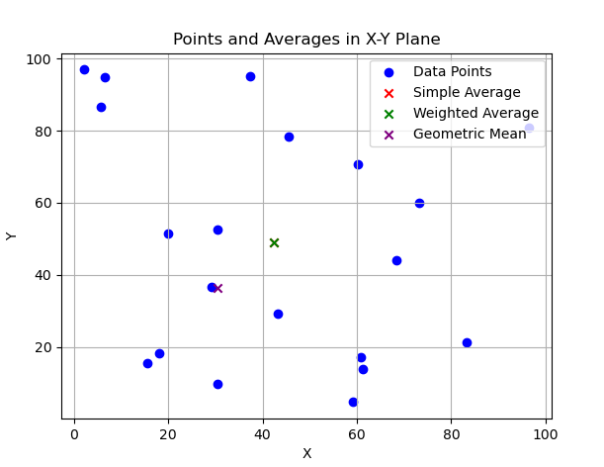
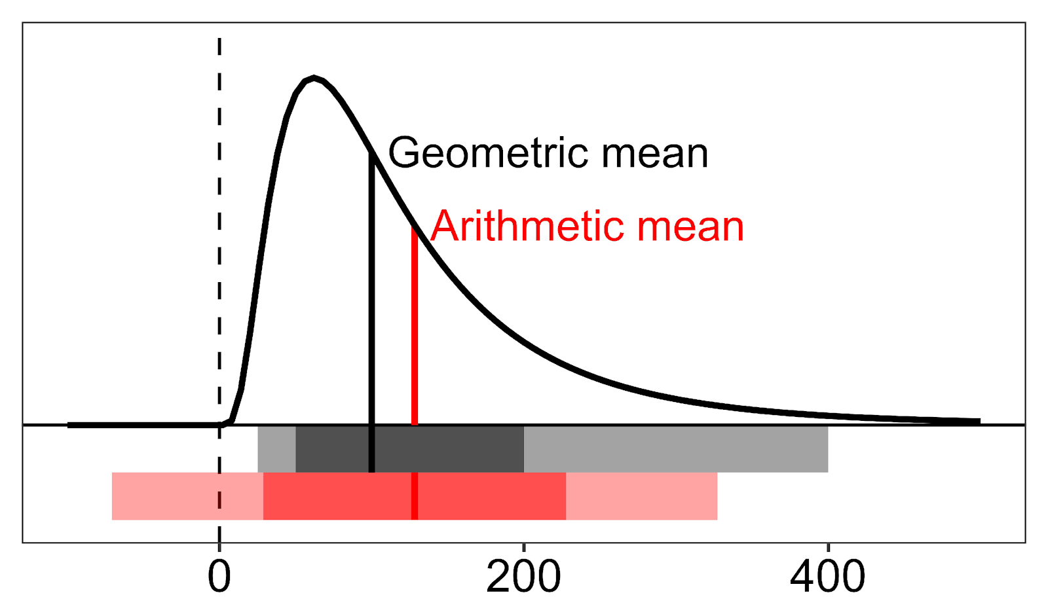
#71 - Virtual Mouse using mmWave Radar (TI)

Slide 19
Vector map
Left-to-Right Movement Vector Map
#71 - Virtual Mouse using mmWave Radar (TI)

Slide 20
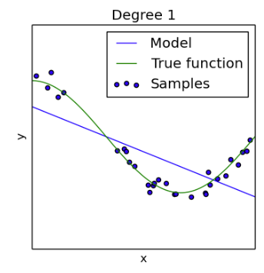
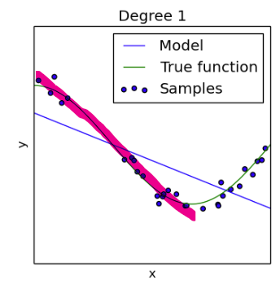

Slide 21
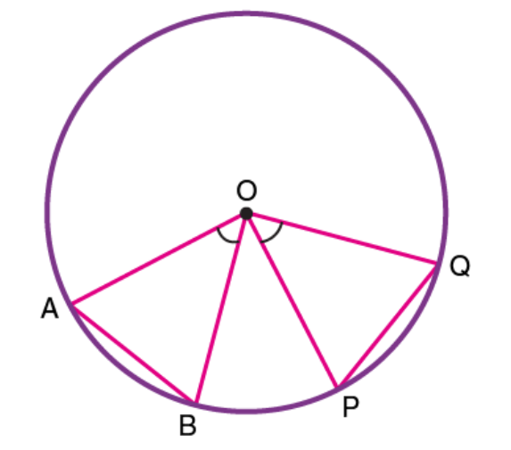
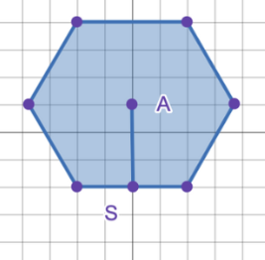
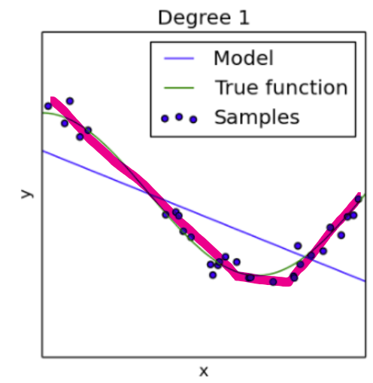
average weight trending line solution

Slide 22
Input Mapping
Zane Meikle
Accomplishments since the last presentation <9> hours | Ongoing progress/problems and plans until the next presentation
<1> meeting with sponsor <3> testing mouse and getting minecraft working <3> writing initial frame gen program <2> research into how to parallelize in Python | Problems: issues with frame gen subprocess not ending when the rest of the program end. Ongoing Progress: Working on fixing the issue with the subprocess not ending. Plans: fixing the frame gen program and getting it ready for integration.
#71 - Virtual Mouse using mmWave Radar (TI)

Slide 23
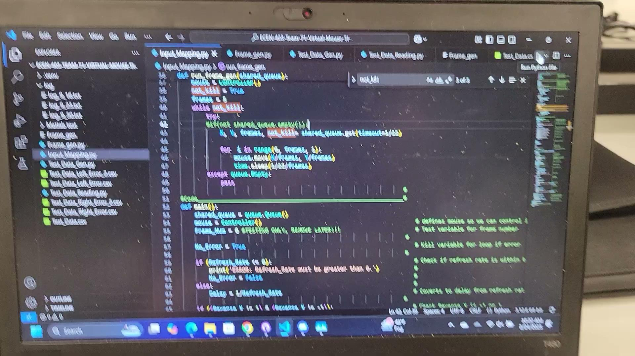
#71 - Virtual Mouse using mmWave Radar (TI)

Slide 24
Parts Ordering Status
We do not need any new parts as such we haven’t ordered any.
#71 - Virtual Mouse using mmWave Radar (TI)

Slide 25
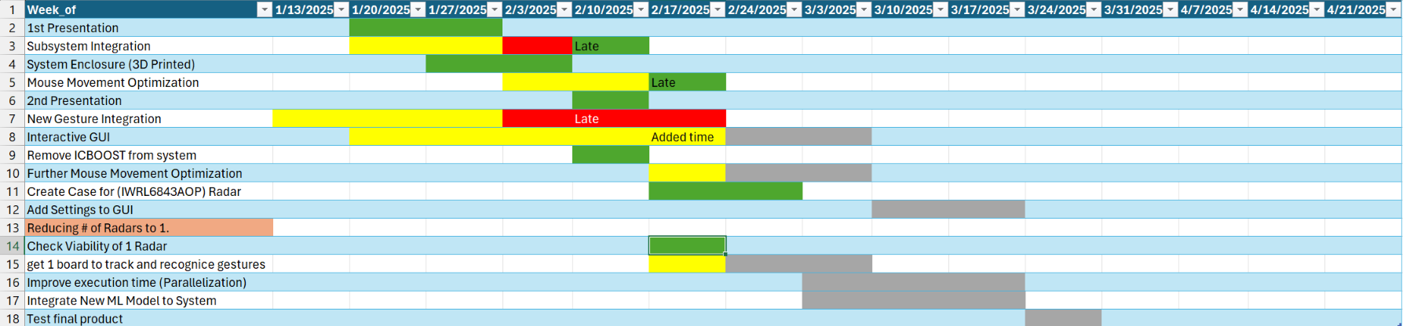
Execution Plan Gantt Chart
#71 - Virtual Mouse using mmWave Radar (TI)

Slide 26
Validation Plan
Section | Task | Specification | Result | Owner
3.2.1.6 | Mouse Movement | Mouse can be moved to all corners of the screen by the program. | Passed | Zane
3.2.1.6 | Mouse Actions | The program must be able to right click and left click. | Passed | Zane
3.2.5.2 | Mouse Input Error Handling | The program must properly handle all invalid inputs. | Passed | Zane
3.2.1.4 3.2.1.6 | Gesture positioning | The coordinates of the gesture should be calculated when deleting the error points. | Passed | Daniel
3.2.1.6 3.2.1.8 3.2.3.2.1 | Velocity accuracy | The output velocity of the moving gesture should not have errors. | Passed | Daniel
3.2.1.5 | Hand Gesture Recognition | ML model can recognize the users hand gestures | Passed | Oscar
#71 - Virtual Mouse using mmWave Radar (TI)

Slide 27
Validation Plan
Section | Task | Specification | Result | Owner
3.2.1.5 | Gesture Recognition Accuracy | ML model can correctly identify and categorize hand gestures at least 90% of the time. | Passed | Oscar
3.2.1.7 | Functional Radar System | The IWR6843AOPEVMs, and MMWAVEICBOOSTs all properly communicate with the computer and transmit data. | Passed | Greyson
3.2.1.8 | Data Decoding | The python script accurately decodes the TLV data seen from both radars. | Passed | Greyson
3.2.1.3 3.2.1.4 | Radar Angle and Distance | The radars can capture gestures and pointer positions within a 90 degree range up to 1.5 feet | Passed | Greyson
3.2.1.5 | Hand Size | Radar will recognize gestures regardless of hand size. | Passed | Oscar
#71 - Virtual Mouse using mmWave Radar (TI)

Slide 28
That is all, thank you.

